Slide 1
Section 6.5
Area of a Surface of Revolution

Slide 2
All graphics are attributed to:
Calculus,10/E by Howard Anton, Irl Bivens, and Stephen Davis Copyright © 2009 by John Wiley & Sons, Inc. All rights reserved.

Slide 3
Introduction
In this section we will find the area of a surface that is generated by revolving a plane curve about a line.
It is very similar to section 6.4, therefore, the equation is very similar to that of arc length.
The difference is that we need to revolve it around a line like we did in sections 6.2 and 6.3.
Since we are only rotating the outside curve (not the area between it and the axis or line), each small section will be approximated by the circumference of the circle infinitesimally narrow width.

Slide 4
Examples Rotated about the x-axis

Slide 5
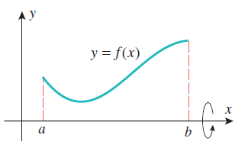
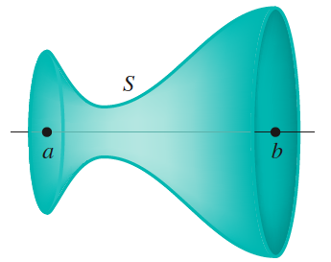
Around the x-axis

Slide 6
Break the Surface into Small Sections

Slide 7
Calculate Surface Area Using Riemann Sums
Each of the subintervals into which we broke the surface area on the previous slide (figure b) is called a frustum which is a portion of a right circular cone.
As we allow the number of subintervals to approach infinity, the width of each approaches zero.
Each subinterval gets closer and closer to resembling a circle who’s circumference is r.
We calculated the length of each subinterval in figure a on the previous slide last class using the distance formula.

Slide 8
Combine the Distance Formula and the Circumference
The arc length (distance) formula from last class and the circumference which represents the rotation around a line combine together to generate the following Riemann sum-like expression:
When we take the limit as the number of subintervals approaches infinity, this Riemann sum will give us the exact surface area.

Slide 9
Integral – when about the x-axis

Slide 10
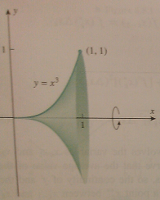
Example about the x-axis

Slide 11
Integral – when about the y-axis

Slide 12
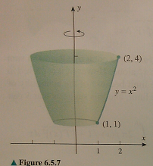
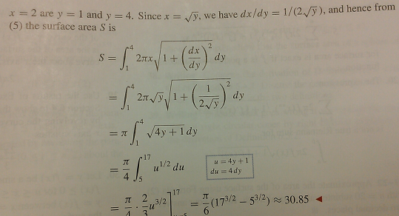
Example about the y-axis

Slide 13
At my cousin’s wedding

